Slide 1
Webmaster Update
Notes:
Update on the Websites and communications

Slide 2
Phil Harbidge - PathControl, General Manager - Kuala Lumpur
21+ years Wellbore Positioning
Well Placement, CA, Risk Assessment, Survey QAQC & Optimization
ISCWSA Webmaster and QAQC Sub-committee Chair, Drilling Data
Quality and Uncertainty Description Sub-Committee member
Work : PathControl : Intercept, Relief Well, P&A, Wellplacement, Survey Management,
Advanced Survey Corrections, Software Setup,
Database Audits, Training and more
Worked :
Sperry-Sun, Baker Hughes INTEQ and Schlumberger: DD Service Companies
Marine Surveyor and Civil Engineer and the Planetary Space Science Research Institute

Slide 3
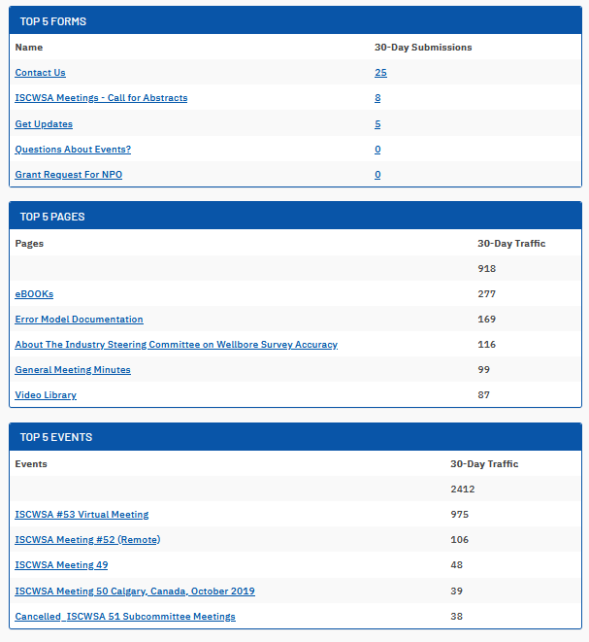
ISCWSA.net Update
Highlites:
Pages hit rate is up !!
918 in last 30 days 14th April 2021
637 in previous 30 days in Oct 2020

Slide 4
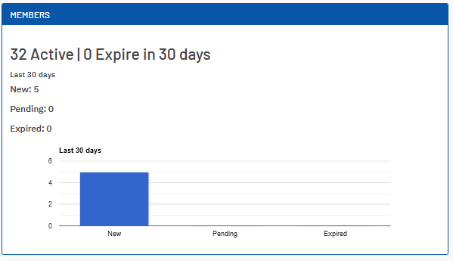
ISCWSA.net Update
Lowlite :
Membership is only at 32 !!
Keep trying to register,
send a support message to Tendenci
and Cc me.
Link for submitting a Tendenci Support Ticket:
https://www.tendenci.com/tickets/

Slide 5
SPE.org Wellbore Positioning Technical Section
- Click this link to join the SPE.org hosted WBPTS
https://www.spe.org/member/access/OnlineCommunityPreferences/EditOnlineCommunityPreferences
- You must be an SPE member to join technical sections
We have a New link for the ISCWSA Training Course is hosted on our iscwsa.net website
https://www.iscwsa.net/events/105/
Education Sub Committee will share more on the course roll out

Slide 6
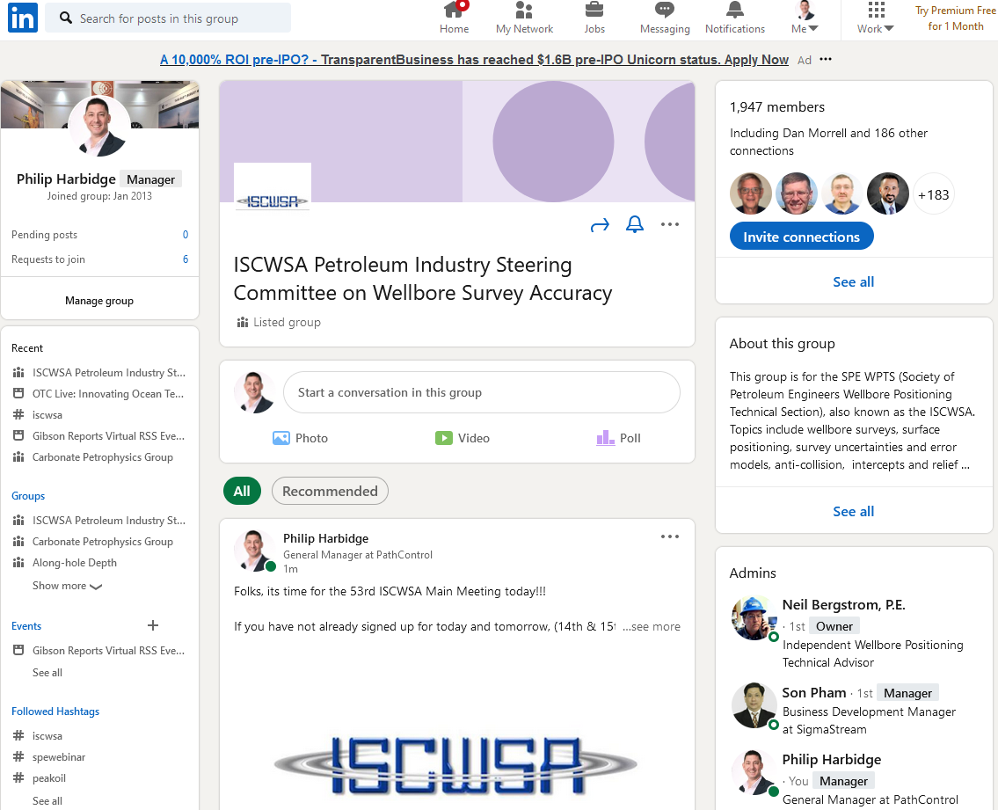
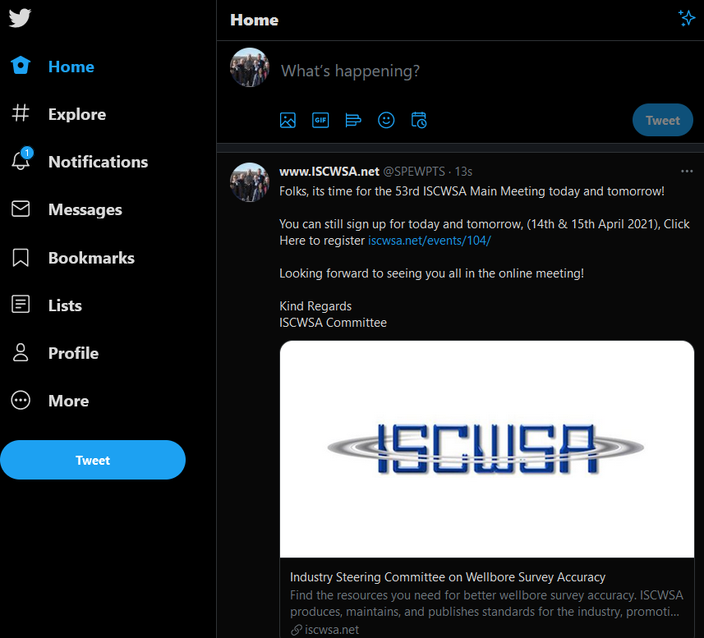
Notes:
We maintain our publicity engines using Linkedin with 1947 signed up members and Twitter with 3 ;) All is public posted updates and helps to spread the word on or events and great publications and training firepower.

Slide 7
Thank you Tendenci ISCWSA Committee Sub-Committee Chairs All Members supported and participated in the new website
Notes:
Thanks to tendenci for working with us, and the ISCWSA community, please work with me to fix thew membership sign up for main group and the sub-committees.

Slide 8
Questions

