Slide 1
Membership Update

Slide 2
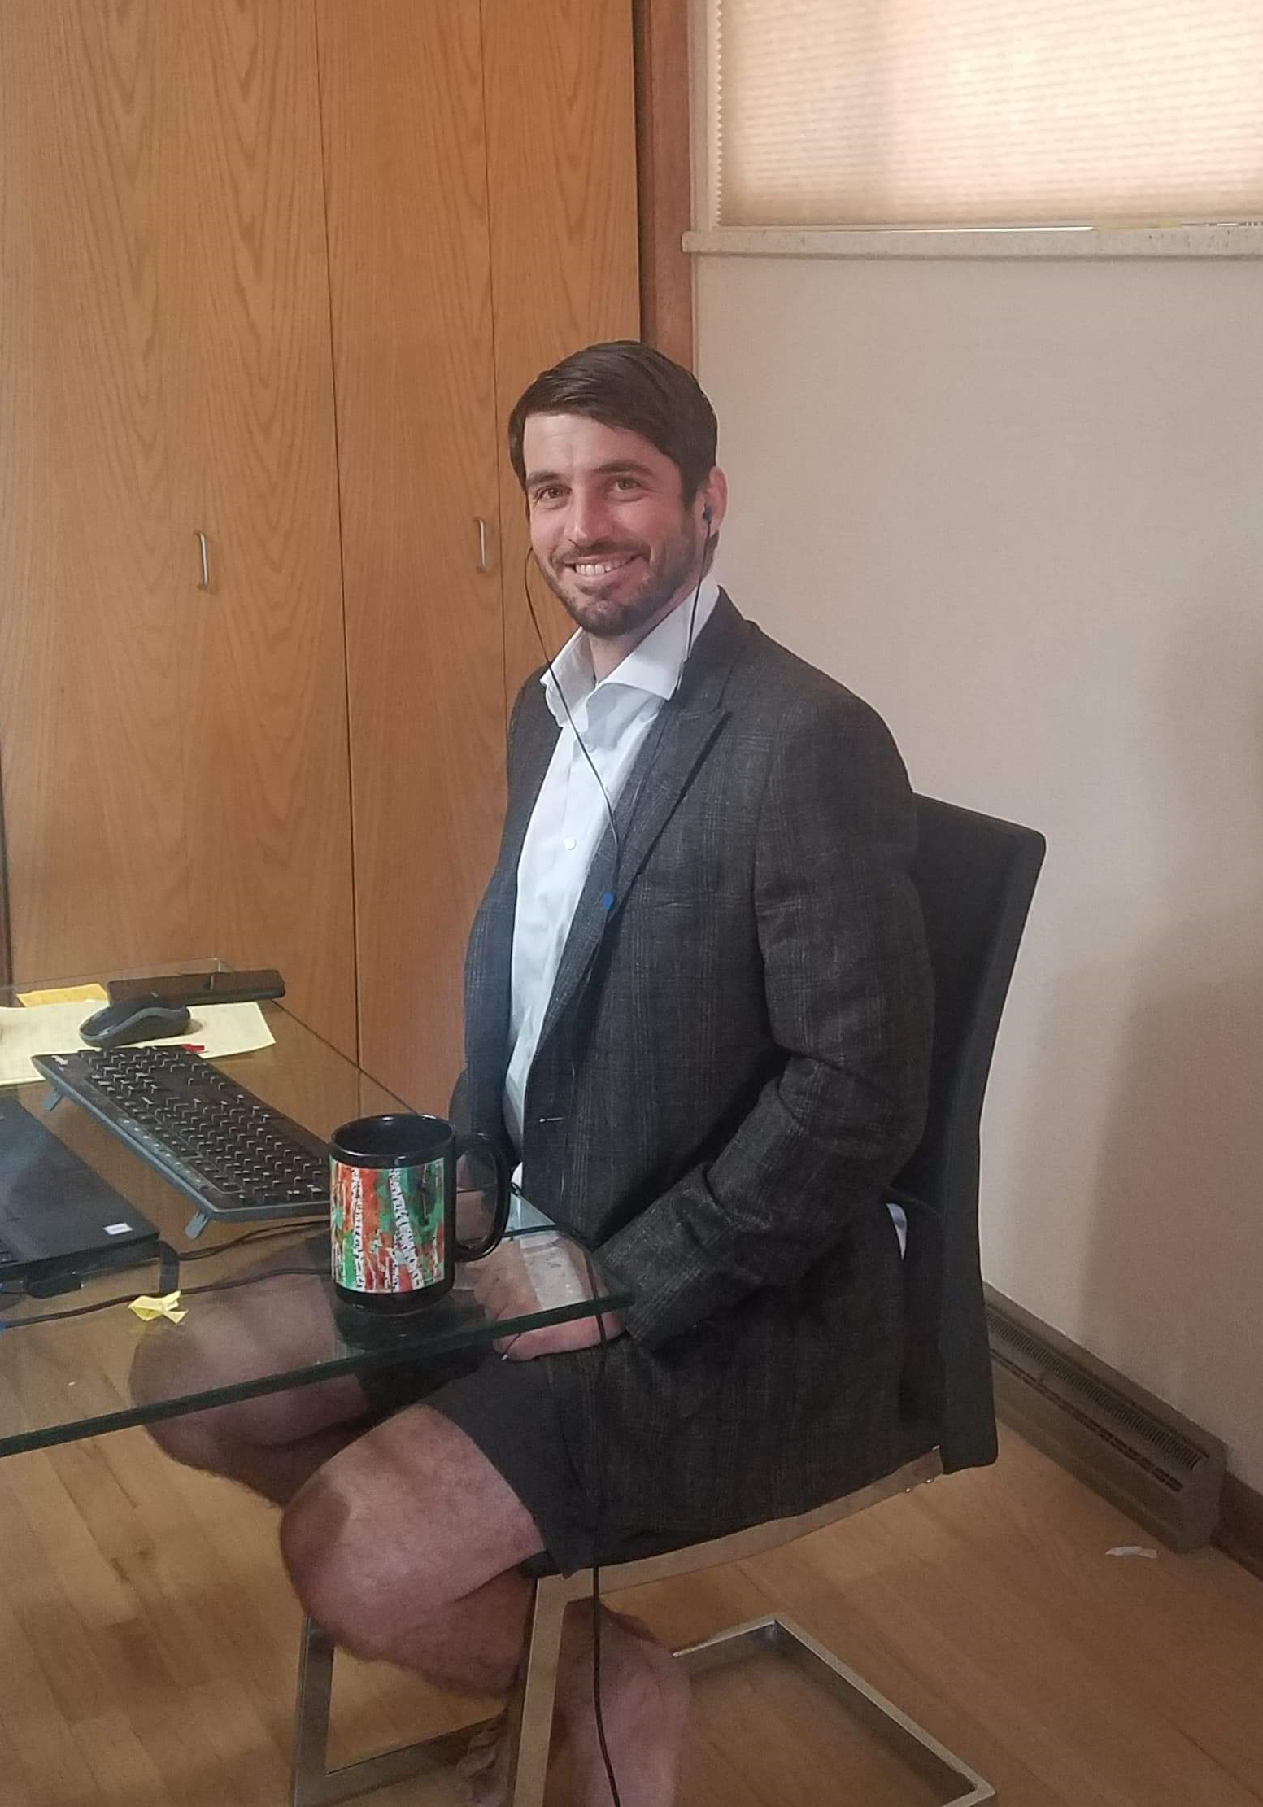
Membership Chair: Marc Willerth
Formerly:
Scientific Drilling
Schlumberger
Conferences in Quarantine

Slide 3
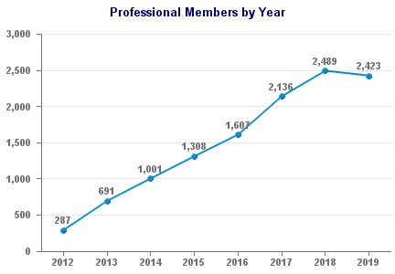
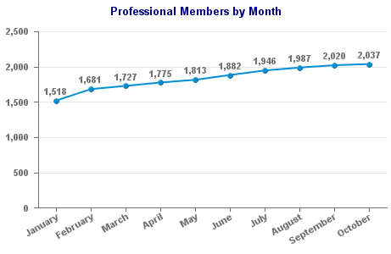
Official Membership is Further Down

Slide 4
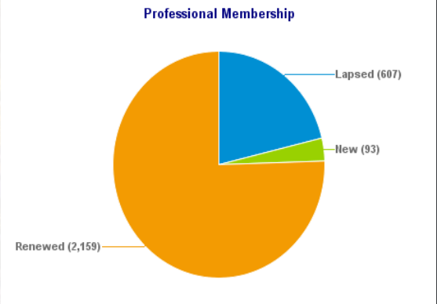
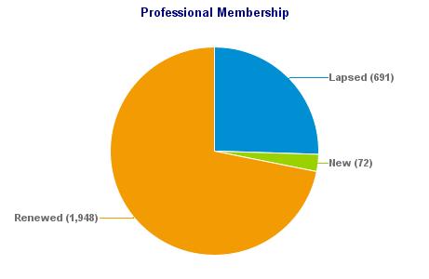
Primary Cause is SPE Membership Lapse
2019
2020

Slide 5
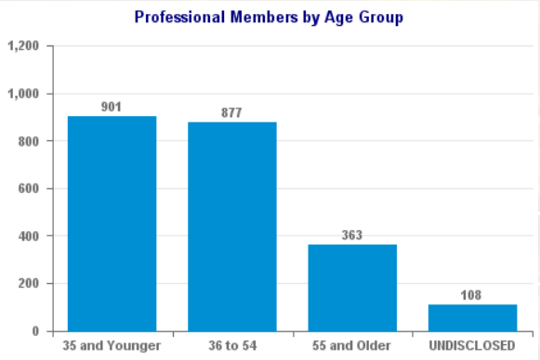
Lapses Worse Among Younger Groups
2019
2020

Slide 6
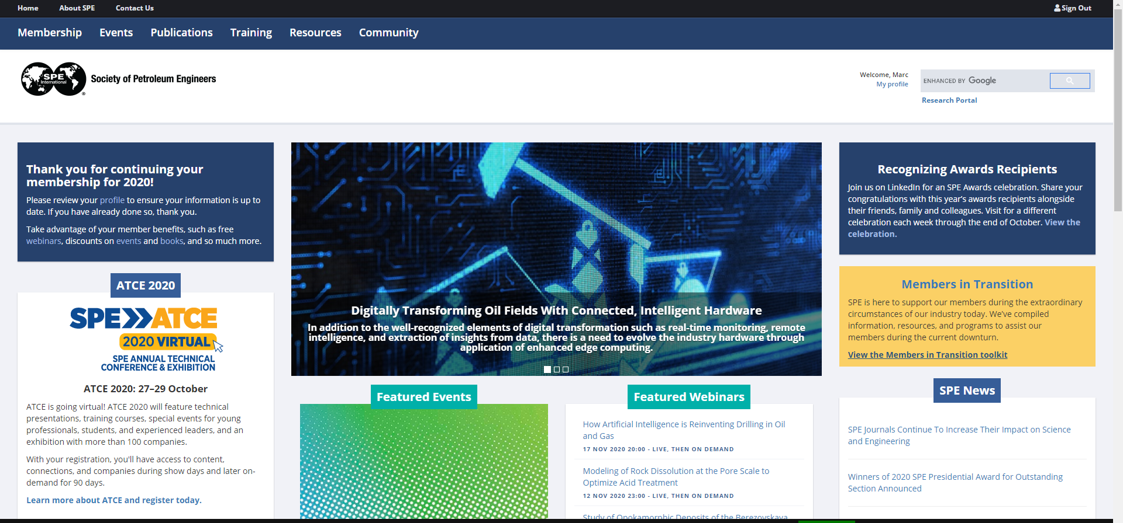
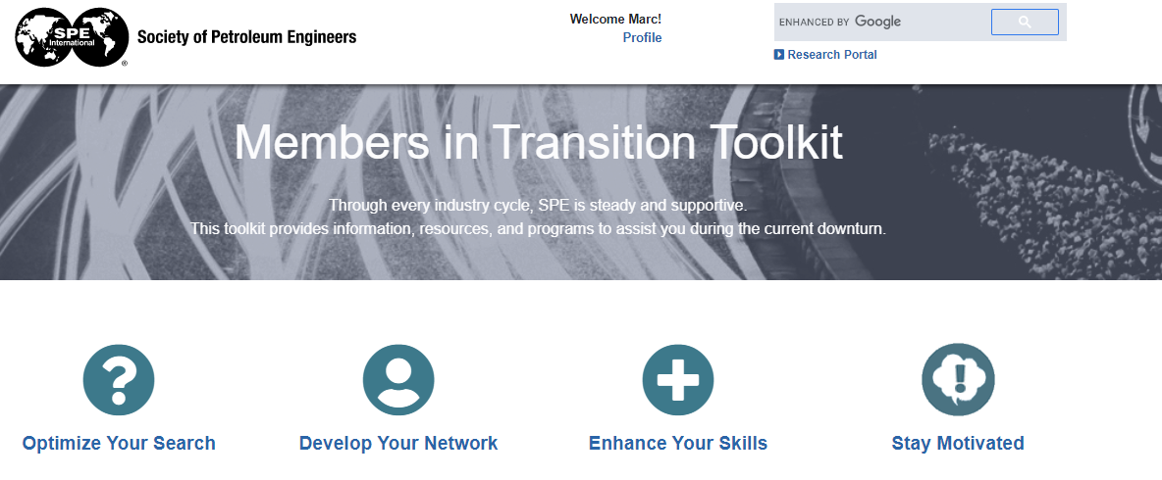
Member in Transition Resources: SPE.org

Slide 7
Asks from SPE
Renew your SPE membership!
Confirm membership in WPTS
Nominate regional award candidates
Nominate distinguished lecturers

Slide 8
Value Proposals for SPE Membership

Slide 9
Membership Data

Slide 11
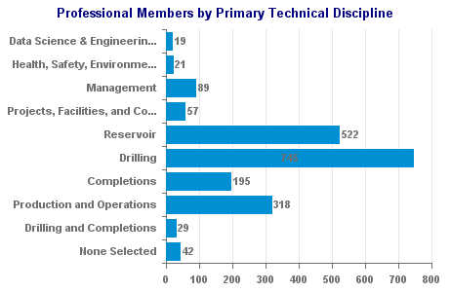
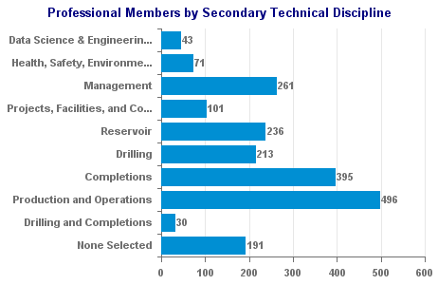

Slide 12
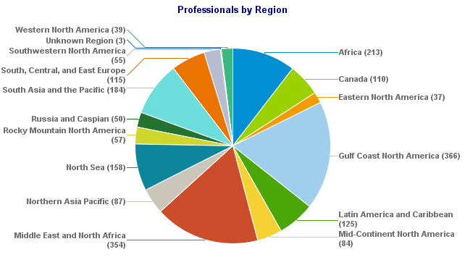

Slide 13
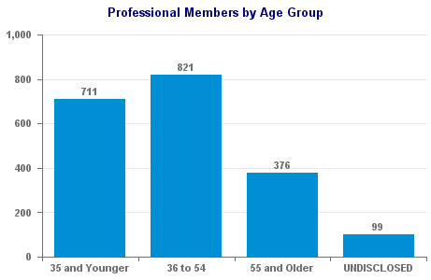

Slide 14
